Slide 1
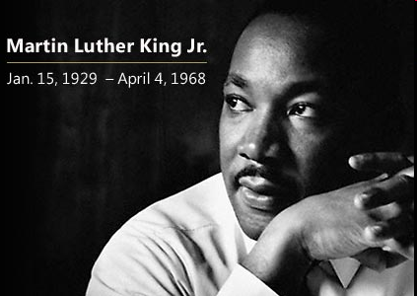
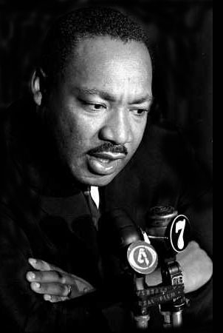
Where Do We Go From Here: Chaos or Community
March 1967

Slide 2
Concepts Employed in the Conference
Recovery - Integrated Care – Medical Home –Behavioral Health- Cultural Competence – Psychiatric Rehabilitation – Fee for Service – Managed Care - Accountable Care Organization – Parity – Family Support – Housing – Peer Specialists – Peer Support – Supported Housing – Consumer -Support – Regionalization – Dual Diagnosis – Block Grant – Advocacy – Community Mental Health – Federally Qualified Health Center – Electronic Records - Tele-health – Primary Care – Mental Health First Aid – Crisis Intervention Training –
Transparency – Empowerment – Technical Assistance – Health Exchanges – Prevention – Early
Intervention – Transformation – Collaboration Institutionalization – Involuntary
Commitment – Deinstitutionalization DSM V – Leadership – Mental Health
Literacy- Health Literacy – Treatment Genome – CRIPA – Resilience –
Community – Social Determinants - Empowerment – Cultural Sensitivity
Essential Health Benefits – Diagnosis Disparities – Inequality – Inequity –
Public Awareness – Evidence Based Practice – Evidence Based Policy –
Medicaid – Medicare – CHIP - Consumers – Survivors – Workforce -
Seclusion & Restraint – Forced Medication – Lobotomy – State Hospitals – Forensic
Services – Randomized Trials - Solution Focused – Innovations – Morbidity Rates –
Mortality Rates – Information Technology - Social Networks – Emergency Services – Family Burden – Adverse Childhood Experiences – Outreach – Addiction Public Law – Indirect Costs – Olmstead v. L.C. – Wyatt v.
Stickney – New Freedom Commission – Crisis Intervention Training – Family Support – Practice Based Evidence – Community Based –Wellness – Well-being – Long Term Care – Acute Care – Case Management – Care Management – Risk Factors – Professions –
University Training – Research – Epidemiology – Organizations – Churches – Legislatures – Supreme Court – Governors – Disruption –
Non-profits - Direct Costs – Productivity – Diversity – Accreditation – Trust – Passion – Credibility –Dependency – Human Rights –
Cultural Empowerment – Cultural Humanity – Reinvention – Health Homes – Self- Promotion – Segregation – Life Style – Theory –
Financing – Redistribution – Affordable Care Act – Social Supports - Ice Breakers – Closure – Liberia -
School
Virtual
Urban/Rural
Workplace
Faith

Slide 3
Tensions in The Second Decade of the 21st Century
Social | Economic | Political | Populations | Policies
Abortion | Outsourcing | Size of Govt. | Hispanic | Roe v. Wade
Gay Rights | Poverty | Unions | Asian | Court Cases
Immigration | Employment | States Rights | African | Arizona Law
Gun Control | Trade | Entitlements | Indian | Court Cases
Contraception | Wealth | Health Care | Anglo | Child Births
Women | Recession | Palestine | Muslims | Research
Religion Racethnicity | Oil Gasoline | Military Power |  | Medicare Medicaid
HIV-AIDS | Housing | Deficit |  | Constitution
Obesity | Savings | Division |  | Jobs
Smoking | Debt | Corporations |  | Spending
Sugar/Salt | Redistribution | Foreign Pol. |  | Environment
Marijuana | Productivity | Foreign Aid |  | States Rights
Crime | China | Supreme Ct. |  | Social Sec.
Sexuality |  | Voting |  | Mergers

Slide 4
Social determinants are multiple factors and conditions operating within a social environment that collectively influences the health status, behavior, choices, risks, and mortality of individuals and groups within a specific geographical area [nation, region, county, neighborhood, or community].
Davis, 2012

Slide 5
Uninsured
Maternal/
Infant
Deaths
Literacy
Nutrition
Crime
Victims
Sickle
Cell
Low Birth
Weight
Babies
Criminal
Justice
Sentencing
Diabetes
Housing &
Homelessness
Cardiovascular
Disease
Periodontal
Disease
Voting
Political
Office
HIV
Asset
Accumulation
Sub-Prime
Loans
Community
Strengths
Cancer
Obesity
Graduation
Rates
Low
Income
Cocaine
Use/Sale
Mental
Retardation
Depression
Schizophrenia
Domestic
Violence
Bipolar
Homicides
Personality
Disorder
Dementia
Capital
Punishment
Unemployment
King Davis, 2003
Notes:
This slide shows a large number of concentric circles with a label for each. The labels are of various kinds of human problems from low income to cancer. The intent of the slide and the labels is to suggest that the range of problems in communities of color is complex, over-lapping, and reinforcing.

Slide 6
Social Support
Social support is a type and degree of help that is provided from others to a person, group, neighborhood, city, organization, or community throughout the lifespan. There is a relationship between social support, maintenance of well-being, and the ability to manage crisis, illness, recovery, loss, or the influence of negative social determinants.

Slide 7
Path Dependence Analysis
Professions
>Funding
Social Support
Fragmentation
Rewards
States Rights
Isolation
Courts
Usage
Rate
Science
Community Mis-trust
Beliefs
University
Training
Racial, Ethnic, Language issues
Stigma
Fear

Slide 8


Slide 9
Future Direction
Policies – state, federal, evidence, funding, licensure
Participation – voting, membership, contributions, email, letters, organizing,
Public Office – preparing next generation of leaders, legislators, governors, mayors, deans, university presidents
Partnerships – community, churches, organizations, successful models,
        youth involvement, international,
Planning – conceptualizing the future, messaging, technology, business we’re in, preparation,
Protest – occupy something! Supreme Court, universities, congress,

Slide 10
Risks
Individualism – as Causation
Delimited Government -
Community Exhaustion -
Societal Exceptionalism –
Mis-understanding Help-Seeking
Raised Expectations –

Slide 11
Actions
Develop & Support Community Organizations
Training for Peer Support
Establish Referral Networks with Churches & Primary Care Providers
Availability of Technology
Techniques for Increasing Community Involvement
Techniques for Involvement in Decision-making
Voting & Office Holding

Slide 12
Actions
Closure of state hospitals en mass
Closure of state departments of mental health
What if behavioral health closed immediately –would we create the same system or Liberian
Changes in licensure requirements
Changes in the training and re-training requirements
Shift in control to communities as opposed to professionals
Greater involvement and responsibility for service design by recipients of service
Shift in services to prevent dependency

Slide 13
Integrated Community Collaborative Care
Employment
Primary Care
Pastoral Care
School
Health
Substance Abuse
Housing/Welfare
Dental Care
Justice/Courts
Mental Health

Slide 14
Neighbors
Emotional Appraisal
Support Support
Informational Instrumental
Support Support
History & Tradition
Leaders
Well-being &
Recovery
Well- Being
Social Determinants
Family
Friends
Social
Determinants
Media
Providers
Organizations
Churches
Social Network/Capital

