Slide 2
ACMHA (American College of Mental Health Administration) Summit
How Social Supports Can Change the Health of a Community
    Wilma Townsend, M.S.W.
    Acting Associate Director, Office of Consumer Affairs, Center for Mental Health Services,
    Substance Abuse and Mental Health Services Administration
Notes:
Good afternoon everyone. My name is Wilma Townsend and I’m the Acting Director of the Office of Consumer Affairs, which is based within the Center for Mental Health Services at SAMHSA.
During today’s presentation, I’ll discuss how social supports—emotional, informational, instrumental, and tangible—can change the health of a community and share with you the Eight Dimensions of Wellness, which guide SAMHSA’s Wellness Initiative.

Slide 3
Nearly half of the U.S. population will experience some mental disorder in their lifetime.*
  *Kessler, R. C., Berglund, P., Demler, O., Jin, R., Merikangas, K. R., & Walters ,E. E. (2005). Lifetime prevalence and age-of-onset distributions of DSM-IV disorders in the National Comorbidity Survey Replication. Archives of General Psychiatry, 62:593-602.
Notes:
Did you know that nearly half of the U.S. adult population will experience some mental disorder in their lifetime?

Slide 4
More than a quarter of Americans ages 18 years or older had a diagnosable mental or substance use disorder in a given year.**
  **Kessler, R. C., Chiu, W. T., Demler, O., & Walters, E.E. (2005). Prevalence, severity, and comorbidity of 12-month DSM-IV disorders in the National Comorbidity Survey Replication. Archives of General Psychiatry, 62:617-27.
Notes:
And more than 25 percent of American adults were diagnosed with a mental or substance use disorder in a given year.
Living with mental illness can be both frustrating and highly hazardous to one’s health. People with behavioral health disorders die decades earlier than the general population, with cardiovascular disease being the main cause.
It has been proven that there is a correlation between mental illness and physical health:
Individuals with severe mental illness experience diabetes, hypertension, dyslipidemia, and obesity at a rate of 1.5 to 2 times the general population.
Depression has been shown to increase the risk of stroke in women.
Individuals with behavioral health problems represent a large proportion—up to one-third—of all Americans who die from coronary heart disease and stroke.
The economic costs of co-morbid behavioral health problems and cardiovascular diseases are significant.

Slide 5



Cardiovascular Disease
is the leading cause of death in the U.S.
Notes:
Cardiovascular disease is an issue affecting all communities and all families.
Tobacco: 75 percent of individuals with behavioral health problems smoke cigarettes, as compared to 23 percent of the general population. Half of all deaths from smoking occur among individuals with mental and substance use disorders.
Obesity: A study of obese people with binge-eating problems found that 51 percent also had a history of major depression.
Other Substance Use—Alcohol and Drugs: Heavy and binge drinking is associated with numerous health problems, including damage to liver cells, inflammation of the pancreas, various cancers, high blood pressure, and psychological disorders.

Slide 6


Notes:
Through its Wellness Initiative, SAMHSA pledges to promote wellness for people with mental and substance use disorders by motivating individuals, organizations, and communities to take action and work toward improved quality of life, cardiovascular health, and decreased early mortality rates.

Slide 7

Million Hearts “ABCs”
A
SPIRIN for people at risk
B
LOOD PRESSURE control
C
HOLESTEROL management
S
MOKING Cessation
Notes:
Through its Wellness Initiative, SAMHSA has partnered with Million Hearts™, a national initiative through the Centers for Disease Control and Prevention to prevent one million heart attacks and strokes over 5 years.
This partnership enables SAMHSA to further its work with the trained peer workforce as well as other community-based organizations and services to become a catalyzing force for a whole-person approach to wellness among individuals with mental and substance use disorders and their families.
With this partnership, SAMHSA’s Wellness Initiative will continue to address early mortality among people with behavioral health problems with a specific focus on preventing the leading causes of death—heart disease and stroke.
As part of this campaign, we ask people to keep the Million Hearts’ ABCs in mind every day and especially when they talk to their doctor:
Appropriate Aspirin Therapy for those who need it
Blood Pressure Control
Cholesterol Management
Smoking Cessation

Slide 8

Spring into Wellness
Notes:
So What Is Wellness?
We must think of wellness like a growing plant. There are several elements, such as sunlight, nourishment, protection and support, needed to ensure that a small plant can blossom into a healthy tree. Like plants, people need a combination of specific elements to spring into a life of wellness, too.
Wellness is not the absence of disease, illness, and stress, but the presence of:
Purpose in life
Active involvement in satisfying work and play
Joyful relationships
A healthy body and living environment
Happiness
Each aspect of wellness can affect overall quality of life, so it is important to consider all aspects of health. This is especially important for people with mental health problems, because wellness directly relates to the quality and longevity of one’s life.

Slide 9
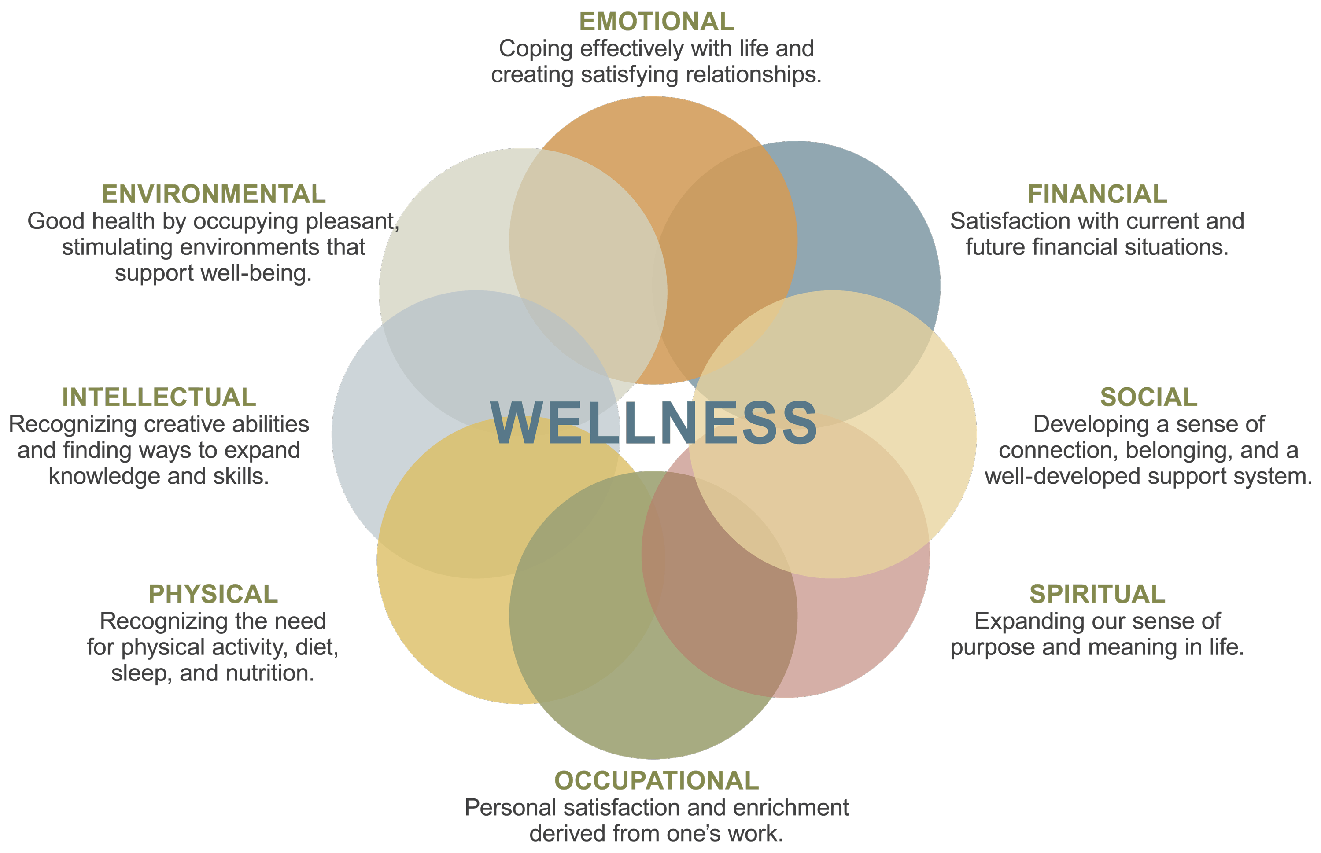
Eight Dimensions of Wellness
Notes:
The eight dimensions of Wellness are emotional, environmental, financial, intellectual, occupational, physical, social, and spiritual.
Each of these dimensions allows for the incorporation of the ABCs of cardiovascular health—aspirin, healthy blood pressure and cholesterol levels, and smoking freedom.

Slide 10



Eight Dimensions of Wellness
Physical
Notes:
Physical Dimension of Wellness—Recognizing the need for physical activity, healthy foods, and sleep
Tips:
Stay active! Take the stairs, walk instead of drive, or join a local sports league.
Make healthy food choices and see how much better you feel.
Sleep is as important as diet and exercise.
See your primary care doctor regularly.
Stay informed about your medications. Ask your doctor about side effects.
Don’t smoke and avoid the use and abuse of substances, such as alcohol, drugs, and caffeine.

Slide 11


Eight Dimensions of Wellness
Emotional
Notes:
Emotional Dimension of Wellness—Coping effectively with life and creating satisfying relationships
Tips:
Be aware of your feelings.
Express your feelings to others.
Learn coping mechanisms to overcome troubling emotions.

Slide 12


Eight Dimensions of Wellness
Social
Notes:
Social Dimension of Wellness—Developing a sense of connection, belonging, and a well-developed support system.
Tips:
Make a short list of family, friends, and peers who are supportive and positive.
Make at least one connection per day by calling, emailing, or visiting a friend or family member.
Join a book club or support group. Volunteer!

Slide 13


Eight Dimensions of Wellness
Occupational
Notes:
Occupational Dimension of Wellness—Personal satisfaction and enrichment from one’s work
We don’t always think about our jobs or careers as part of overall health. Personal satisfaction and a sense of purpose often enter one’s life through work.

Slide 14


Eight Dimensions of Wellness
Intellectual
Notes:
Intellectual Dimension of Wellness—Recognizing creative abilities and finding ways to expand knowledge and skills
Creative and stimulating activities add another dimension to wellness. Learning new things and pursuing personal interests are a part of a healthy lifestyle.

Slide 15


Eight Dimensions of Wellness
Financial
Notes:
Financial Dimension of Wellness—Satisfaction with current and future financial situations
Tips:
Make conscious decisions regarding spending and budgeting.
Plan and prepare for future circumstances.

Slide 16


Eight Dimensions of Wellness
Environmental
Notes:
Environmental Dimension of Wellness—Good health by occupying pleasant, stimulating environments that support well-being
Tip:
Find pleasing surroundings that encourage good physical and mental health.

Slide 17


Eight Dimensions of Wellness
Spiritual
Notes:
Spiritual Dimension of Wellness—Expanding our sense of purpose and meaning in life
Spiritual health can mean different things to different people. For many people, spirituality can provide meaning and purpose to their lives.

Slide 18
Eight Dimensions of Wellness
Notes:
The eight dimensions of Wellness are emotional, environmental, financial, intellectual, occupational, physical, social, and spiritual.
Each of these dimensions allows for the incorporation of the ABCs of cardiovascular health—aspirin, healthy blood pressure and cholesterol levels, and smoking freedom.

Slide 19
Please Tell Us…
Of the Eight Dimensions of Wellness, which dimension seems to be the most difficult for communities to promote and leverage in assisting individuals with mental health and substance use disorders with their self-empowerment process?
What do you think communities can do differently to overcome the challenge you just identified?

Slide 20
Take the Pledge for Wellness
  We envision ...
  A future in which people with mental and substance use disorders pursue optimal health, happiness, recovery, and a full and satisfying life in the community via access to a range of effective services, supports, and resources.
  We pledge ...
  To promote wellness for people with mental and substance use disorders by taking action to improve the quality of life and reduce early mortality.
  Visit http://www.samhsa.gov/wellness to take the pledge
  for you or your organization
Notes:
Sign SAMHSA’s Pledge for Wellness and take action to improve the quality of life and reduce early mortality for people with mental and substance use disorders by promoting wellness.
Take the pledge and join the thousands of individuals and organizations already committed to promoting wellness and working to reduce early mortality and improve quality of life for people with mental and substance use disorders, and people in recovery.

Slide 21
Contact Information
  Wilma Townsend, M.S.W.
  Acting Associate Director
  Office of Consumer Affairs
  Center for Mental Health Services
  Substance Abuse and Mental Health
  Services Administration
  1 Choke Cherry Road
  Rockville, MD 20850
  (240) 276–1948
  wilma.townsend@samhsa.hhs.gov
  Lauren Spiro, M.A.
  Mental Health Communication Manager
  Vanguard Communications
  2121 K Street, NW
  Suite 650
  Washington, DC 20037
  (703) 862–6512
  laurenspiro1@gmail.com
Notes:
That concludes the presentation. Please pass your cards up to the front and thanks again for taking the time to fill them out.
Learn more about taking action to support SAMHSA’s efforts, improving the quality of life, and reducing early mortality by signing the Pledge for Wellness on our website at http://www.samhsa.gov/wellness. Thanks again!

