Slide 1


ACMHA 2014
The Power of the Person
Jen Padron, MEd, CPS, QMHP-CS and Ron Manderscheid, PhD
Debbie Plotnick, MHANY - The Person
Jana Spalding, MD, Recovery Innovations – Peer Support
Explore the future role of the person receiving care
What do the practices of shared decision-making and the concept of mutuality tell us about future individual responsibility for health?
Notes:
Imagine a future when I arrive at my health care provider’s with a list of requests and he/she reviews that with me to ensure they are all met. After the visit, I may return in a week, a month, a year, two years, ten years or not at all.
Imagine a future where my healthcare consists of habits created with support, with an occasional consultation with a healthcare professional.
Imagine a future where every diagnosis comes with the expectation of recovery and the goal of treatment is to render future treatment unnecessary.
Imagine a future where a typical health care session ends with the question: Have we met all your goals for today? Is there anything else we can do to support you in your recovery?
Imagine a future where people who have insurance through their job can access peer support, recovery education, supportive housing, supportive employment, wellness coaching, whole health peer support, peer respite services and peer crisis services.
Imagine a future where a peer supporter can establish a business and people will pay for their services.
Imagine a health home where the dentist and the psychiatrist collaborate on care, where the surgeon is aware of a person’s history, say, of co-occurring disorder, and uses that in the selection of anesthesia and pain medication.
Imagine a future where the entire family can receive integrated health care from one location where they are supported as a family and not only as individuals.
Imagine a future where the electronic health record is under the control of the person and is open and available to them at all times.

Slide 2


The Power of the Person
Explore the future role of the person receiving care
…and the impact that individual action can have on health outcomes, cost, and whole health.
Notes:
The future can be now: a power shift occurs where the individual, who now is the needy party, fighting to have his/her needs met by an all-powerful, often unresponsive system, becomes the powerful party. Instead of a consumer of services who must choose from what is available, the person determines what they need, pursues it and then leaves the system, incorporating necessary changes into their lifestyle. The interaction with the system is time limited, because recovery presupposes the ability to live outside of the health care system when sufficient progress has been made. The system adjusts to meet the individual needs across the spectrum from education, information, support, technological resources, primary care, laboratory analysis, treatment, monitoring, surgical/tertiary intervention. Chronic illness and lifelong treatment model changes to illness that is addressed with professional health until that professional health is no longer needed. At every point along the way care is person-centered, the individual being at the core of decision making.

Slide 3
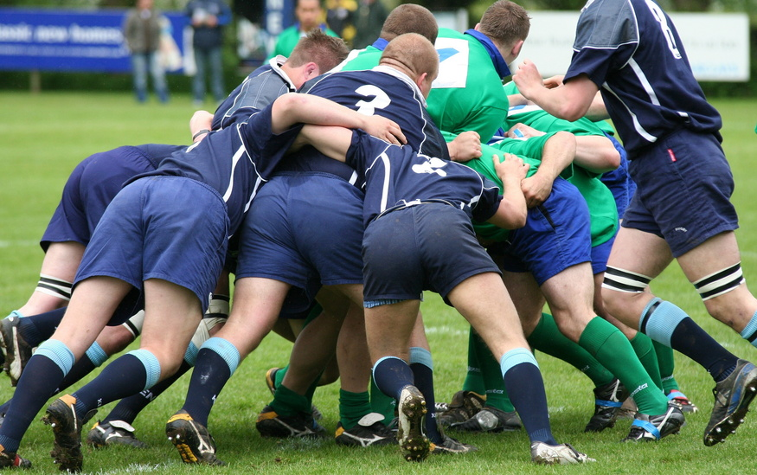
The Power of the Person

Slide 4
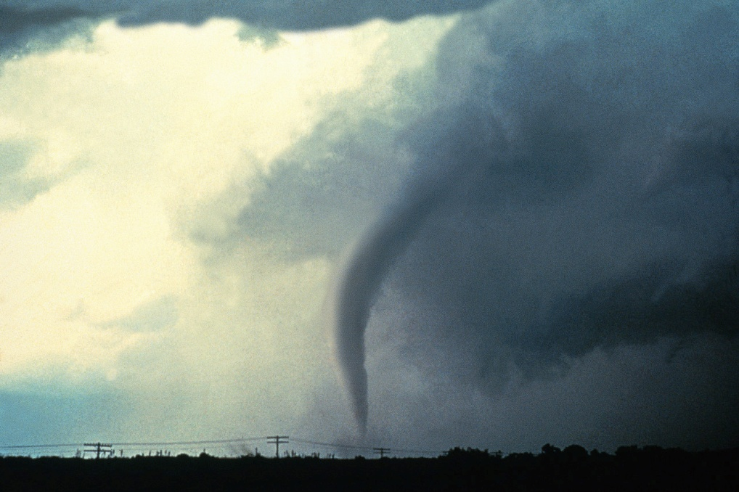


The Power of the Person

Slide 5


The Power of the Person

Slide 6
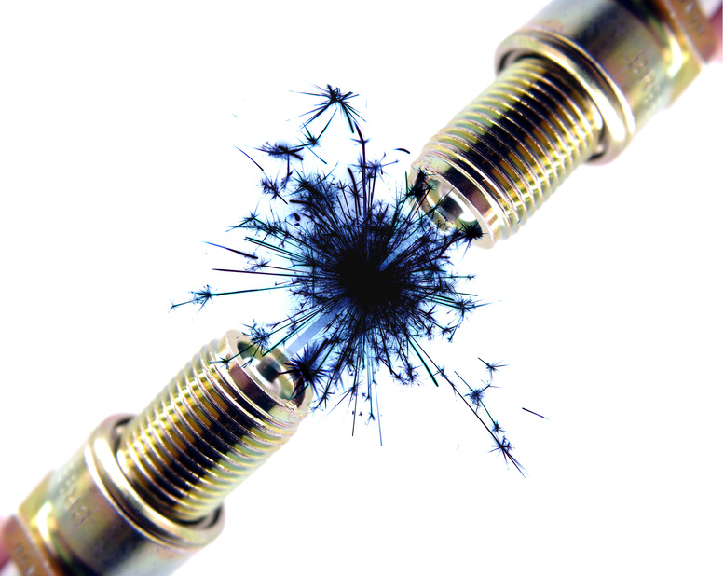
The Power of the Person

Slide 7

The Power of the Person

Slide 8
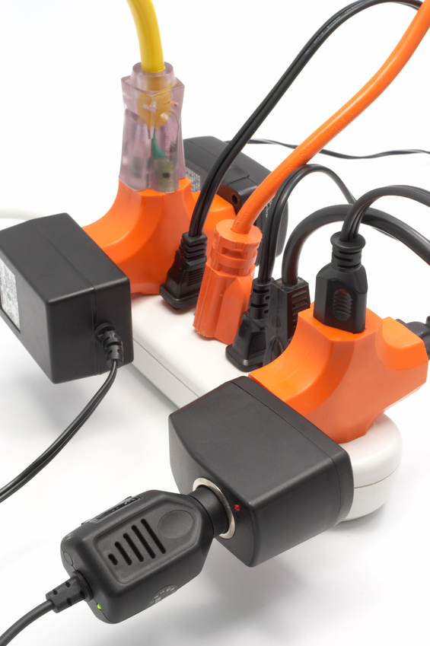

The Power of the Person

Slide 9


The Power of the Person

Slide 10


The Power of the Person

Slide 11
The Power of the Person

Slide 12
The Power of the Person
To pursue recovery and wellness armed with information, resources, tools and coping skills.
To obtain support necessary to live life to the fullest beyond the confines of the health care system.
Notes:
My idea of goals. Yours? Pause for conversations. End of intro and Section 1. Announce that future discussions will follow themes of:
Me, Myself and I
Our Peer World
My Beloved System
Ask if any other constructs/strategies/suggestions

Slide 13
The Power of the Person
How do we create this future?
Notes:
I propose that we structure our discussions as follows:
1. Me, myself and I. If I am to be the change I want to see in the world I can’t ask the world to change without being willing to change. Since this future is different than the present, we are looking at changing. How do I change?
2. Our peer world: can we build kingdoms, as in video games? Is it a matter of strategy, technical know how and reading the markets? Or is there something more fundamental—staying true to the peer while swimming in the big, big ocean of health care
3. My beloved system: my dysfunctional family, that has so many times crushed me in the name of helping me. Bring me your wounded, your professionals, your institutions, your clinicians from teeming academia, yearning to be set free…not really. The town of Stepford thought they wanted Stepford wives and went about creating them in a false image. Likewise, the professionals think they know what they want. They don’t know what they don’t know. Medical model we rail against might be closer to recovery in physical medicine than behavioral practice. It’s not that big of a change, and what we bring has value. The BH clinicians learned it; the others can too. When the student is ready….

Slide 14
The Power of the Person
1. Me, Myself and I
Notes:
I propose that we structure our discussions as follows:
1. Me, myself and I. If I am to be the change I want to see in the world I can’t ask the world to change without being willing to change. Since this future is different than the present, we are looking at changing. How do I change?
2. Our peer world: can we build kingdoms, as in video games? Is it a matter of strategy, technical know how and reading the markets? Or is there something more fundamental—staying true to the peer while swimming in the big, big ocean of health care
3. My beloved system: my dysfunctional family, that has so many times crushed me in the name of helping me. Bring me your wounded, your professionals, your institutions, your clinicians from teeming academia, yearning to be set free…not really. The town of Stepford thought they wanted Stepford wives and went about creating them in a false image. Likewise, the professionals think they know what they want. They don’t know what they don’t know. Medical model we rail against might be closer to recovery in physical medicine than behavioral practice. It’s not that big of a change, and what we bring has value. The BH clinicians learned it; the others can too. When the student is ready….

Slide 15
Two Sources of Learning, Two Learning Cycles
A. Learning by reflecting on the experiences of the past
act - observe - reflect - plan - act
B. Learning from the future as it emerges Presencing –connecting to the Source of your authentic Self
Theory U
Otto Scharmer, Presencing Institute
Notes:
Section 2. Theory U as a way to disect the process of change. In peerdom, this is our expertise. Seen through the eyes of business leadership thinkers. Slides 14-20.

Slide 16

Four Levels of Responding to Change
Manifest
action
1. Reacting: quick fixes
Process,
structure
2. Redesigning: policies
Thinking
3. Reframing: values, beliefs
Source
of energy,
inspiration
and will
4. Regenerating: sources of commitment and energy

Slide 17
The Blind Spot of Leadership
Results:
What
Process:
How
Source:
Who
Blind Spot: Inner place
from where we operate

Slide 18
“The success of an intervention depends on the interior condition
of the intervenor.”
William O’Brien,
former CEO of the Hanover Insurance Company

Slide 19
3 Movements of the U
Observe,
observe,
observe
Act in an
instant
Retreat and reflect:
Allow the inner knowing to emerge

Slide 20
Retreat and reflect:
Allow the inner knowing to emerge
Presencing: connect to the sources of your authentic Self

Slide 21
Retreat and reflect:
Allow the inner knowing to emerge
peer coaching practices: deep listening
leadership offsite: our collective journey
Personal practices: places of stillness: Who is my Self? What is my Work?

Slide 22
The Power of the Person
2. Our Peer World
Notes:
Section 3. Our Peer World. Slides 22-26. I propose that we structure our discussions as follows:
1. Me, myself and I. If I am to be the change I want to see in the world I can’t ask the world to change without being willing to change. Since this future is different than the present, we are looking at changing. How do I change?
2. Our peer world: can we build kingdoms, as in video games? Is it a matter of strategy, technical know how and reading the markets? Or is there something more fundamental—staying true to the peer while swimming in the big, big ocean of health care
3. My beloved system: my dysfunctional family, that has so many times crushed me in the name of helping me. Bring me your wounded, your professionals, your institutions, your clinicians from teeming academia, yearning to be set free…not really. The town of Stepford thought they wanted Stepford wives and went about creating them in a false image. Likewise, the professionals think they know what they want. They don’t know what they don’t know. Medical model we rail against might be closer to recovery in physical medicine than behavioral practice. It’s not that big of a change, and what we bring has value. The BH clinicians learned it; the others can too. When the student is ready….

Slide 23
ACMHA 2014
The Power of the Person in the Future
Our Peer World
Explore the future role of the person receiving care and the impact that individual action can have on health outcomes, cost, and whole health. What do the increasing practices of shared decision-making and the concept of mutuality tell us about future individual responsibility for health?
Notes:
Imagine a future when I arrive at my health care provider’s with a list of requests and he/she reviews that with me to ensure they are all met. After the visit, I may return in a week, a month, a year, two years, ten years or not at all.
Imagine a future where my healthcare consists of habits created with support, with an occasional consultation with a healthcare professional.
Imagine a future where every diagnosis comes with the expectation of recovery and the goal of treatment is to render future treatment unnecessary.
Imagine a future where a typical health care session ends with the question: Have we met all your goals for today? Is there anything else we can do to support you in your recovery?
Imagine a future where people who have insurance through their job can access peer support, recovery education, supportive housing, supportive employment, wellness coaching, whole health peer support, peer respite services and peer crisis services.
Imagine a future where a peer supporter can establish a business and people will pay for their services.
Imagine a health home where the dentist and the psychiatrist collaborate on care, where the surgeon is aware of a person’s history, say, of co-occurring disorder, and uses that in the selection of anesthesia and pain medication.
Imagine a future where the entire family can receive integrated health care from one location where they are supported as a family and not only as individuals.
Imagine a future where the electronic health record is under the control of the person and is open and available to them at all times.

Slide 24
Our Peer World
Conversation
Mutuality – Respect, Dignity, Power to You
Shared Experience
Strengths First
Support, Support Network

Slide 25
Our Peer World
Conversation
Person-Centered
Holistic
Recovery Language
Systems Serve Society/Systems Serve People

Slide 26
Our Peer World
Conversation
Capacity of individuals and organizations—Build!
One Size Does Not Fit All
Nothing About Us Without Us—How About We Supervise
Beyond the Peer—when we step outside of our cocoons

Slide 27
The Power of the Person
3. My beloved system
Notes:
Section 4. My Beloved System, conclusion. Slides 27-33, 34 contact info.
I propose that we structure our discussions as follows:
1. Me, myself and I. If I am to be the change I want to see in the world I can’t ask the world to change without being willing to change. Since this future is different than the present, we are looking at changing. How do I change?
2. Our peer world: can we build kingdoms, as in video games? Is it a matter of strategy, technical know how and reading the markets? Or is there something more fundamental—staying true to the peer while swimming in the big, big ocean of health care
3. My beloved system: my dysfunctional family, that has so many times crushed me in the name of helping me. Bring me your wounded, your professionals, your institutions, your clinicians from teeming academia, yearning to be set free…not really. The town of Stepford thought they wanted Stepford wives and went about creating them in a false image. Likewise, the professionals think they know what they want. They don’t know what they don’t know. Medical model we rail against might be closer to recovery in physical medicine than behavioral practice. It’s not that big of a change, and what we bring has value. The BH clinicians learned it; the others can too. When the student is ready….

Slide 28
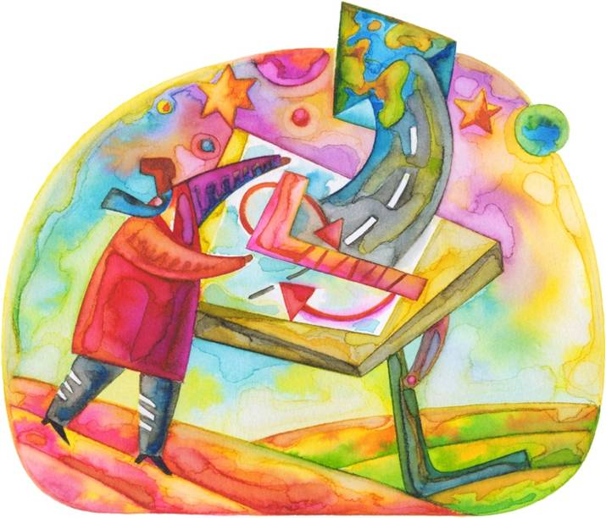
The Power of the Person
Yes, it is my system too
Notes:
I propose that we structure our discussions as follows:
1. Me, myself and I. If I am to be the change I want to see in the world I can’t ask the world to change without being willing to change. Since this future is different than the present, we are looking at changing. How do I change?
2. Our peer world: can we build kingdoms, as in video games? Is it a matter of strategy, technical know how and reading the markets? Or is there something more fundamental—staying true to the peer while swimming in the big, big ocean of health care
3. My beloved system: my dysfunctional family, that has so many times crushed me in the name of helping me. Bring me your wounded, your professionals, your institutions, your clinicians from teeming academia, yearning to be set free…not really. The town of Stepford thought they wanted Stepford wives and went about creating them in a false image. Likewise, the professionals think they know what they want. They don’t know what they don’t know. Medical model we rail against might be closer to recovery in physical medicine than behavioral practice. It’s not that big of a change, and what we bring has value. The BH clinicians learned it; the others can too. When the student is ready….

Slide 29
ACMHA 2014
The Power of the Person
Jen Padron, MEd, CPS, QMHP-CS and Ron Manderscheid, PhD
Debbie Plotnick, MHANY - The Person
Jana Spalding, MD, Recovery Innovations – Peer Support
Explore the impact that individual action can have on health outcomes, cost, and whole health. future individual responsibility for health?
Notes:
Imagine a future when I arrive at my health care provider’s with a list of requests and he/she reviews that with me to ensure they are all met. After the visit, I may return in a week, a month, a year, two years, ten years or not at all.
Imagine a future where my healthcare consists of habits created with support, with an occasional consultation with a healthcare professional.
Imagine a future where every diagnosis comes with the expectation of recovery and the goal of treatment is to render future treatment unnecessary.
Imagine a future where a typical health care session ends with the question: Have we met all your goals for today? Is there anything else we can do to support you in your recovery?
Imagine a future where people who have insurance through their job can access peer support, recovery education, supportive housing, supportive employment, wellness coaching, whole health peer support, peer respite services and peer crisis services.
Imagine a future where a peer supporter can establish a business and people will pay for their services.
Imagine a health home where the dentist and the psychiatrist collaborate on care, where the surgeon is aware of a person’s history, say, of co-occurring disorder, and uses that in the selection of anesthesia and pain medication.
Imagine a future where the entire family can receive integrated health care from one location where they are supported as a family and not only as individuals.
Imagine a future where the electronic health record is under the control of the person and is open and available to them at all times.

Slide 30
ACMHA 2014
The Power of the Person
My Beloved System: Conversation
Explore the impact that individual action can have on health outcomes, cost, and whole health. future individual responsibility for health
Notes:
Imagine a future when I arrive at my health care provider’s with a list of requests and he/she reviews that with me to ensure they are all met. After the visit, I may return in a week, a month, a year, two years, ten years or not at all.
Imagine a future where my healthcare consists of habits created with support, with an occasional consultation with a healthcare professional.
Imagine a future where every diagnosis comes with the expectation of recovery and the goal of treatment is to render future treatment unnecessary.
Imagine a future where a typical health care session ends with the question: Have we met all your goals for today? Is there anything else we can do to support you in your recovery?
Imagine a future where people who have insurance through their job can access peer support, recovery education, supportive housing, supportive employment, wellness coaching, whole health peer support, peer respite services and peer crisis services.
Imagine a future where a peer supporter can establish a business and people will pay for their services.
Imagine a health home where the dentist and the psychiatrist collaborate on care, where the surgeon is aware of a person’s history, say, of co-occurring disorder, and uses that in the selection of anesthesia and pain medication.
Imagine a future where the entire family can receive integrated health care from one location where they are supported as a family and not only as individuals.
Imagine a future where the electronic health record is under the control of the person and is open and available to them at all times.

Slide 31
ACMHA 2014
The Power of the Person – Us is Them
My Beloved System: Conversation
Beware of false dichotomies, grassroots vs. system
Oppressed vs. oppressor
Us vs. Them
Notes:
Imagine a future when I arrive at my health care provider’s with a list of requests and he/she reviews that with me to ensure they are all met. After the visit, I may return in a week, a month, a year, two years, ten years or not at all.
Imagine a future where my healthcare consists of habits created with support, with an occasional consultation with a healthcare professional.
Imagine a future where every diagnosis comes with the expectation of recovery and the goal of treatment is to render future treatment unnecessary.
Imagine a future where a typical health care session ends with the question: Have we met all your goals for today? Is there anything else we can do to support you in your recovery?
Imagine a future where people who have insurance through their job can access peer support, recovery education, supportive housing, supportive employment, wellness coaching, whole health peer support, peer respite services and peer crisis services.
Imagine a future where a peer supporter can establish a business and people will pay for their services.
Imagine a health home where the dentist and the psychiatrist collaborate on care, where the surgeon is aware of a person’s history, say, of co-occurring disorder, and uses that in the selection of anesthesia and pain medication.
Imagine a future where the entire family can receive integrated health care from one location where they are supported as a family and not only as individuals.
Imagine a future where the electronic health record is under the control of the person and is open and available to them at all times.

Slide 32
ACMHA 2014
The Power of the Person
My Beloved System: Conversation
Wellbeing maintained by individual efforts, minimal health care system involvement
Easy crossover from peer support to physical medicine.
Shift to integration is actually small
Notes:
Imagine a future when I arrive at my health care provider’s with a list of requests and he/she reviews that with me to ensure they are all met. After the visit, I may return in a week, a month, a year, two years, ten years or not at all.
Imagine a future where my healthcare consists of habits created with support, with an occasional consultation with a healthcare professional.
Imagine a future where every diagnosis comes with the expectation of recovery and the goal of treatment is to render future treatment unnecessary.
Imagine a future where a typical health care session ends with the question: Have we met all your goals for today? Is there anything else we can do to support you in your recovery?
Imagine a future where people who have insurance through their job can access peer support, recovery education, supportive housing, supportive employment, wellness coaching, whole health peer support, peer respite services and peer crisis services.
Imagine a future where a peer supporter can establish a business and people will pay for their services.
Imagine a health home where the dentist and the psychiatrist collaborate on care, where the surgeon is aware of a person’s history, say, of co-occurring disorder, and uses that in the selection of anesthesia and pain medication.
Imagine a future where the entire family can receive integrated health care from one location where they are supported as a family and not only as individuals.
Imagine a future where the electronic health record is under the control of the person and is open and available to them at all times.

Slide 33
ACMHA 2014
The Power of the Person
Crossing over: We can do this!
Shift to integration is actually small
Notes:
Imagine a future when I arrive at my health care provider’s with a list of requests and he/she reviews that with me to ensure they are all met. After the visit, I may return in a week, a month, a year, two years, ten years or not at all.
Imagine a future where my healthcare consists of habits created with support, with an occasional consultation with a healthcare professional.
Imagine a future where every diagnosis comes with the expectation of recovery and the goal of treatment is to render future treatment unnecessary.
Imagine a future where a typical health care session ends with the question: Have we met all your goals for today? Is there anything else we can do to support you in your recovery?
Imagine a future where people who have insurance through their job can access peer support, recovery education, supportive housing, supportive employment, wellness coaching, whole health peer support, peer respite services and peer crisis services.
Imagine a future where a peer supporter can establish a business and people will pay for their services.
Imagine a health home where the dentist and the psychiatrist collaborate on care, where the surgeon is aware of a person’s history, say, of co-occurring disorder, and uses that in the selection of anesthesia and pain medication.
Imagine a future where the entire family can receive integrated health care from one location where they are supported as a family and not only as individuals.
Imagine a future where the electronic health record is under the control of the person and is open and available to them at all times.

Slide 34
ACMHA 2014
The Power of the Person – Us is Them
Our future: here!
Jana Spalding, MD, CPSS, ITE
Recovery Innovations
Jana.spalding@recoveryinnovations.org
602-769-8280
Notes:
Imagine a future when I arrive at my health care provider’s with a list of requests and he/she reviews that with me to ensure they are all met. After the visit, I may return in a week, a month, a year, two years, ten years or not at all.
Imagine a future where my healthcare consists of habits created with support, with an occasional consultation with a healthcare professional.
Imagine a future where every diagnosis comes with the expectation of recovery and the goal of treatment is to render future treatment unnecessary.
Imagine a future where a typical health care session ends with the question: Have we met all your goals for today? Is there anything else we can do to support you in your recovery?
Imagine a future where people who have insurance through their job can access peer support, recovery education, supportive housing, supportive employment, wellness coaching, whole health peer support, peer respite services and peer crisis services.
Imagine a future where a peer supporter can establish a business and people will pay for their services.
Imagine a health home where the dentist and the psychiatrist collaborate on care, where the surgeon is aware of a person’s history, say, of co-occurring disorder, and uses that in the selection of anesthesia and pain medication.
Imagine a future where the entire family can receive integrated health care from one location where they are supported as a family and not only as individuals.
Imagine a future where the electronic health record is under the control of the person and is open and available to them at all times.

