Slide 1


Health Share’s
Collective Prevention Strategy promoting early life health
2016

Slide 2
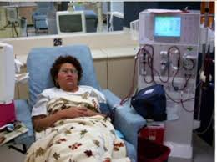

Where we started:
Understanding people with the highest healthcare service/costs utilization
20% of our Medicaid population
uses 85% of the money

Slide 3

Where we started:
Highest utilizing members: People with chronic physical health issues, often complicated by MH issues and SUD
What we built (Health Commons Grant):
Stronger primary care homes
Better transitions from hospital to outpatient care
Integrated mental health care with primary care
…But why are there so many people in that situation?

Slide 4



Health Share’s Life Study
Conducted by the Center for Outcomes Research and Education
Qualitative study of the life course of 47 high utilizing members
Filled in a blank timeline of significant life events
  63% suffered some form of abuse before age 19
  Half started using substances before age 19
  Half dropped out of school
  All struggled to find consistent work

Slide 5
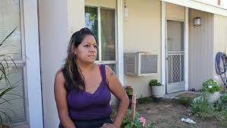
What we learned: Life stories with chain reactions of adversity
Miranda
Tumultuous, violent relationship between parents, unstable housing
Lived with multiple caretakers in various locations
First pregnancy/
birth, stepbrother is father
2 more children, still living in abusive household
Parents split, dad got “left behind”
3 more children born
birth
5 yo
11 yo
15 yo
18 yo
21 yo
27 yo
47 yo
Begins heavy drug use and selling
Goes to prison on drug charges
Suicide attempt
Moves back in with mom, daily sexual abuse from stepfather
Drops out of school
Goes to prison on drug charges
Heavy alcohol use, drug relapses, cancer, car accidents
Age 47
6 children ages 15-32
No GED/diploma, no employment, criminal history
In recovery from severe substance use
Chronic pain, cancer, multiple surgeries, no teeth or dentures
Multiple psychiatric medications

Slide 6
The Prevalence of Adverse Life Experiences
0-6 yo
7-19 yo
30% Suﬀered repeated physical, sexual or emotional abuse in early childhood
22% Had unmet basic needs (food, clothing)
13% Lived with an adult with a substance use issue
17% Were separated from parents
50% dropped out of school
28% Ran away or left home early
30% Became teen parents
15% Became homeless at some point
46% Were substance users
19-30 yo
30% Were arrested or incarcerated at some point
52% Were substance users
26% Were homeless
74% Report job insecurity or become unable to work at all
28% Were separated from their children
30+ yo
NONE able to work
30% Describe being socially isolated
70% Describe struggling to get needed healthcare
30% Struggle to manage their medication
40% Struggle with mental health
What the Numbers Tell Us
Lauren Broffman, Center for Outcomes Research and Education (CORE)

Slide 7


Our Goal:
A healthy, productive next generation of Oregonians
Healthy, productive adult
21 yo +
12-21 yo
Healthy Lifestyle
6-12 yo
Positive Relationships
5 yo
Academic Success
3 yo
Ready for kindergarten
Birth
Strong
Attachments
Pregnancy
Healthy Mom / Child
Wanted Pregnancy

Slide 8

What we see:
Cascading series of adverse events that derail a healthy life course
Pregnancy
Birth
3 yo
5 yo
Unintended pregnancy
Unwanted pregnancy
6-12 yo
Parents not ready to parent
12-21 yo
Adult violence, SUD
Poor attachment
21 yo +
Not ready for kindergarten
Abuse Neglect
Unhealthy adult, high utilizer
Academic failure
Behavioral Problems Skill Deficits
Substance use, criminality
Social isolation and dysfunction

Slide 9
Health Share members

Slide 10
What would this mean for a prevention strategy?
Determine key touch points in the care delivery system where we can provide meaningful support (before pregnancy, during pregnancy, age 0-3)
Understand how to promote stable families with healthy early attachments
Ensure that at risk families get the mental health, SUD treatment and social services they need before a child is born to prevent adverse outcomes
Use the health care system’s frequent contacts with children to help them be ready for kindergarten by age 5

Slide 11
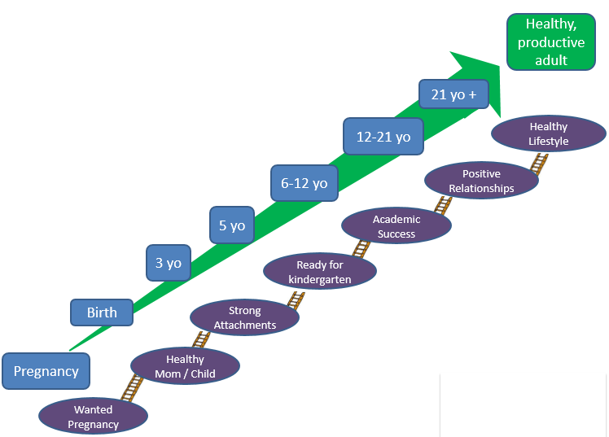
Our Four Part Strategy to
Promote Early Life Health
1. Prevent unintended pregnancies
2. Integrate behavioral health into maternity care
3. Ensure that developmental delays and disabilities in young children are addressed
4. Build support around
children in foster care
in a coordinated way

Slide 12

How? Collective Impact
Use data to understand disparities, gaps, redundancies, synergies
Find, link, and support emerging or promising practices in both healthcare and in the community
When value is demonstrated, develop alternative payment strategy, and scale up

Slide 13

The strategies…
All rely on physical, mental health, and substance use information and approaches
Many include dental
All are seen through the lenses of social, racial, and language disparities
Often are reaching beyond the bounds of “traditional” healthcare delivery and include schools, early learning hubs, public health, communities, paramedics, 911

Slide 14


Where does the money come from?
CCO Incentive Metrics and Scoring Committee
Percentage of global budget for Medicaid is withheld
Transformational metrics are determined
CCOs are incentivized to meet and improve performance levels
Incentive money is meant to be used to transform the system

Slide 15

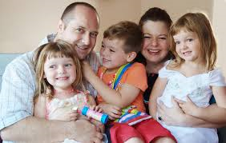



Building a community commitment to early life health

