Slide 1
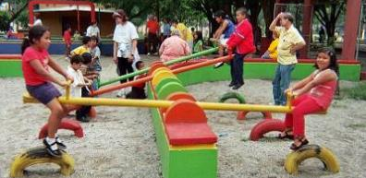

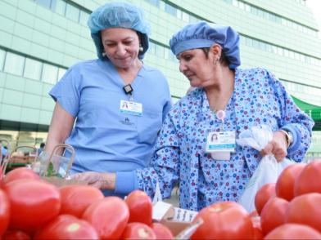


Leading a Paradigm Shift: Opportunities and Skills for Linking Behavioral Health and Population Health
Larry Cohen, MSW
Founder and Executive Director
Prevention Institute
Lynda E. Frost, JD, PhD
Director of Planning and Programs
Hogg Foundation for Mental
Health
College for Behavioral Health Leadership 2016 Summit
April 7, 2016
San Diego, CA
Notes:
Mental Health, Public Health and HealthCare putting prevention in the middle of the puzzle

Slide 2
Presentation Objectives
Linking behavioral health and healthcare through a population health approach
Identifying leadership skills essential to realizing this transformation
Committing to specific audacious yet manageable actions

Slide 3
Interactive Activity #1
First alone, then in your pair, then your small group, compile a list of approaches or action in answer to:
How can leaders ensure that population-based work alienates communities and worsens behavioral health outcomes?
8 minutes, go wild!

Slide 4
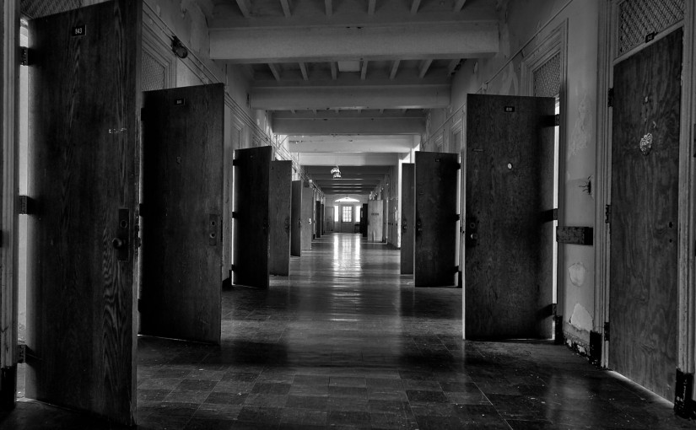
Notes:
Hospital Image

Slide 5
Realizations
Importance of a sense of community
Resilience not just problems
Life skills & work skills
Friends can be good medicine
Moving from what’s wrong with you
to what’s happened to you and understanding what’s good about you: Martha realized she was likable and valuable
It’s not just one person, it’s the system

Slide 6
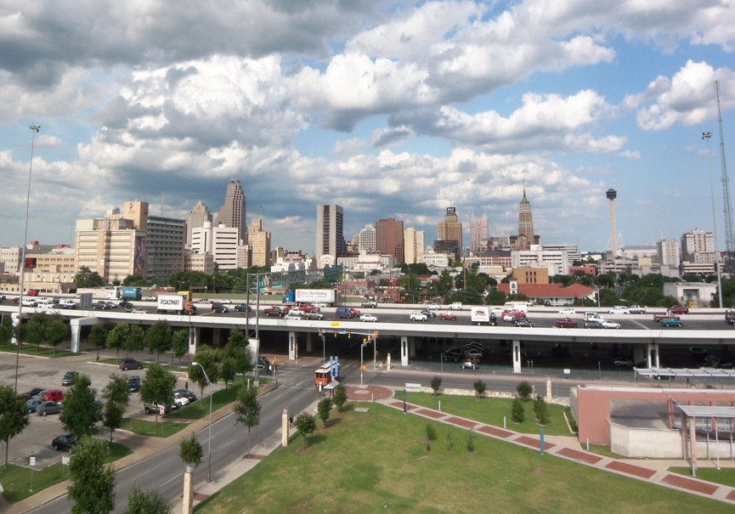
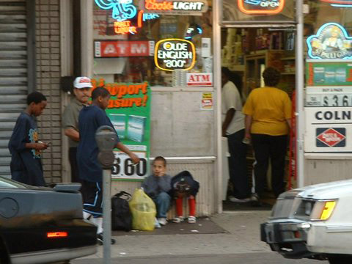
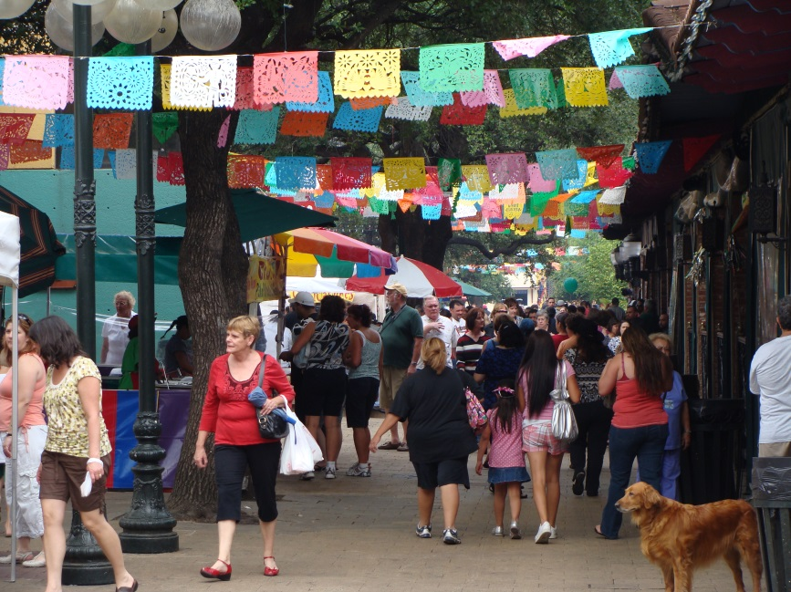
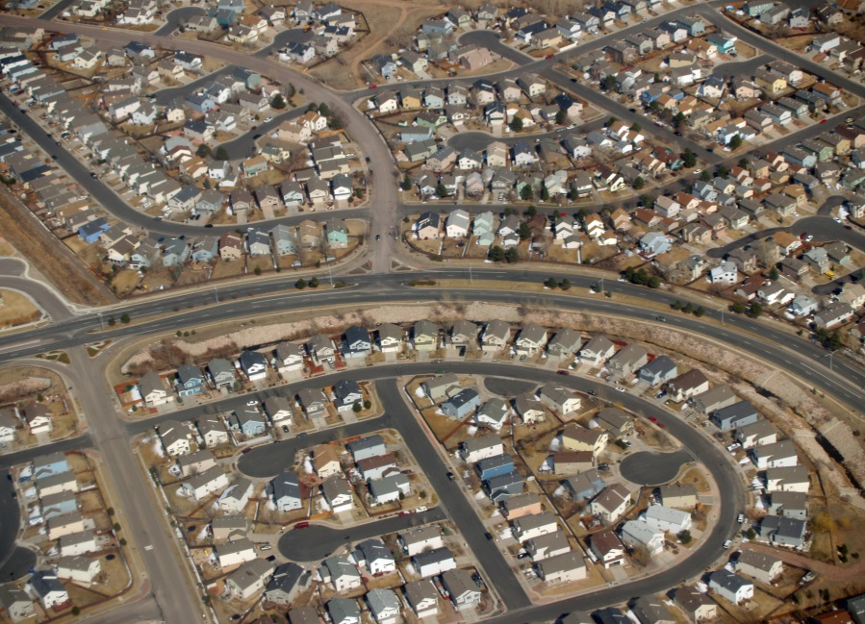
A New Focus on Environments
,
Sources: https://upload.wikimedia.org/wikipedia/commons/thumb/9/90/Downtown_San_Antonio.jpg/640px-Downtown_San_Antonio.jpg, https://encrypted-tbn0.gstatic.com/images?q=tbn:ANd9GcQPcBv9MW2yZwRBFs2EFNFlHs6GlYPfz4GPfMfi-3auAru27YLW3A, https://upload.wikimedia.org/wikipedia/commons/c/c1/Market_Square_SA.JPG, https://upload.wikimedia.org/wikipedia/commons/3/37/Suburbia_by_David_Shankbone.jpg

Slide 7
“
No epidemic has ever been resolved by paying attention to the treatment of
the affected individual.
”
Dr. George W. Albee

Slide 8
ENVIRONMENT
EXPOSURES
HEALTH, SAFETY & BEHAVIORAL HEALTH
BEHAVIOR
BEHAVIOR
Notes:
Environment affects health
Health and safety
Health & safety
Environment
Is it just behavior?
It’s the environment

Slide 9
What’s Behavioral Health Got To Do With It?

Slide 10
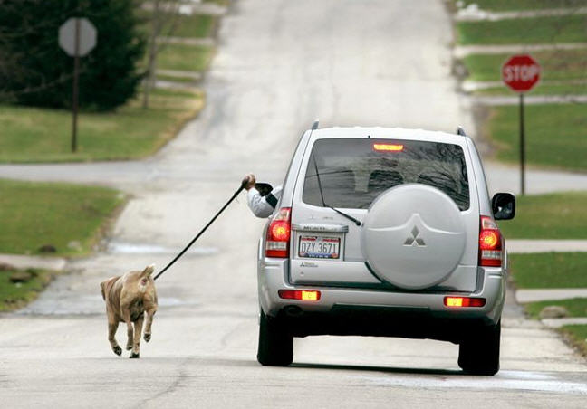

Slide 11
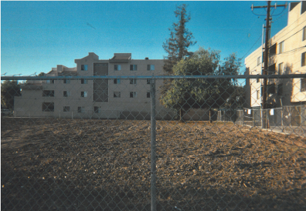
Notes:
I see an empty lot that looks abandoned and filled with trash. I see the fence around the empty lot I know that we could use this place as a place to play sports. By having this and other empty lots around our neighborhood fenced up we fell isolated from each other. We don’t get to interact as much because we don’t have places to play. The bond is broken. We could build a park so that kids my age can stay active healthy and connected. -Daisy Romero, 13, Santa Ana

Slide 12
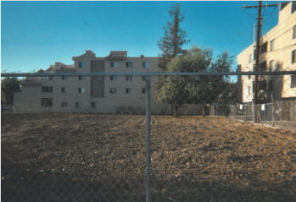
“. . .We could use this place as a place to play sports.
We don’t get to interact as much because we don’t have places to play. The bond is broken. We could build a park so that kids my age can stay active healthy and connected.”
Daisy Romero, Age 13
Photo Voice Project, Santa Ana, CA
Notes:
I see an empty lot that looks abandoned and filled with trash. I see the fence around the empty lot I know that we could use this place as a place to play sports. By having this and other empty lots around our neighborhood fenced up we fell isolated from each other. We don’t get to interact as much because we don’t have places to play. The bond is broken. We could build a park so that kids my age can stay active healthy and connected. -Daisy Romero, 13, Santa Ana

Slide 13
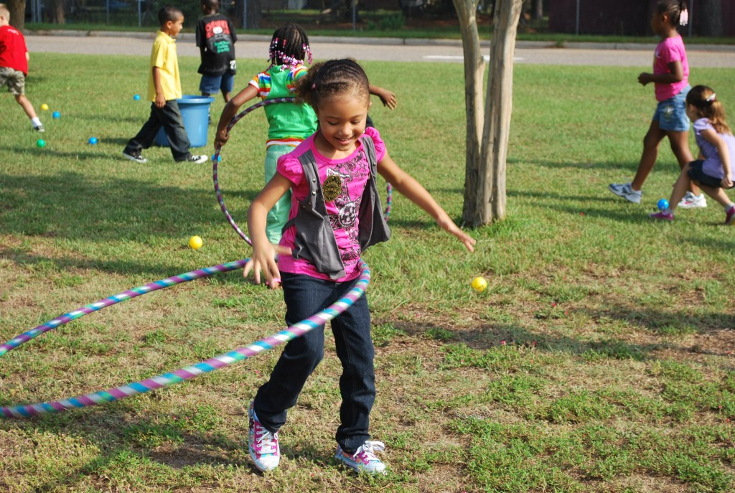
Notes:
13
Calls for inter-agency cooperation to identify community activity needs and plan programs to meet those needs.
Enhances and develops existing recreation facilities.
Increases the number of high-quality community-recreation programs held in public school facilities.
Specifies that county-wide recreation programs should be developed for all age groups, from pre-school to senior citizens.
Promotes partnerships with community agencies and organizations to address childhood obesity.

Slide 14
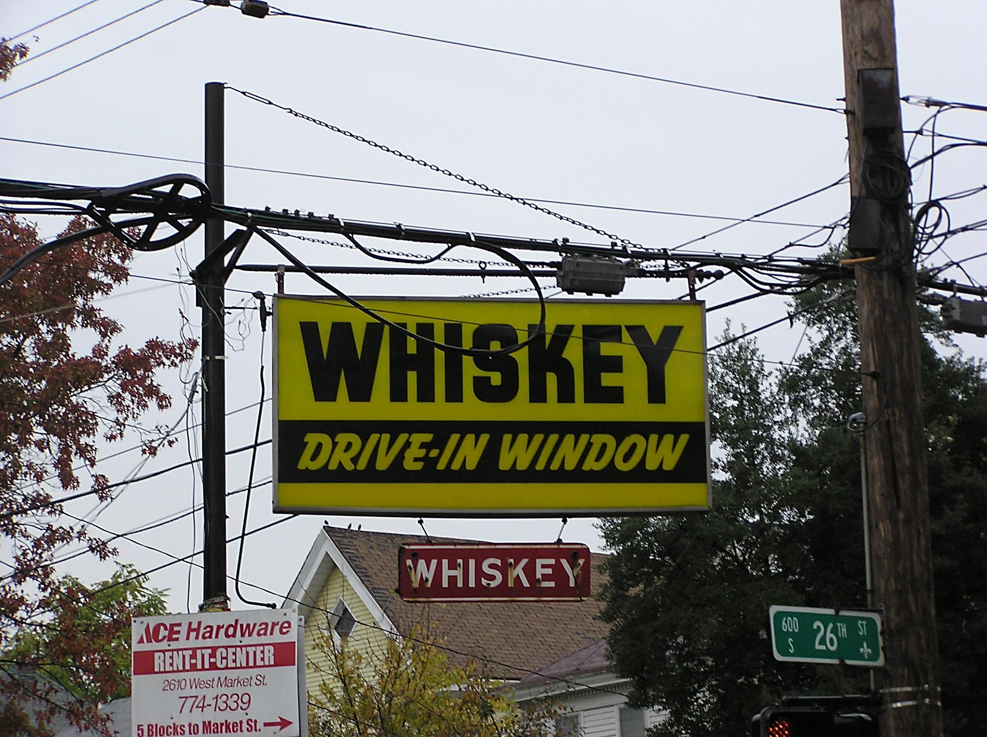
Source: http://c.ymcdn.com/sites/www.safestates.org/resource/resmgr/imported/2%20Cohen.pdf
Notes:
What about now?
What about the environment is causing the problem?

Slide 15
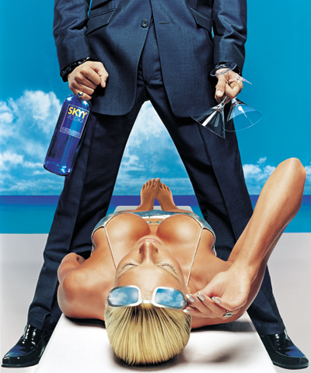

Slide 16


Slide 17
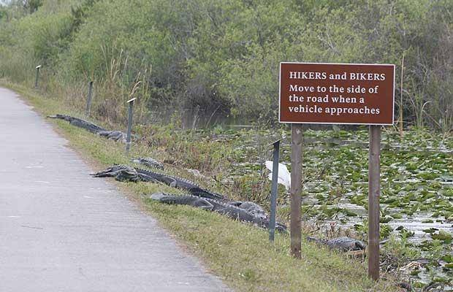

Slide 18
“
It is unreasonable to expect
that people will change their behavior easily when so many forces in the social, cultural, and physical environment
conspire against such change.
”
Institute of Medicine
Source: Institute of Medicine. (2000). Promoting health: Intervention strategies from social and behavioral research (B. D. Smedley & L. S. Syme, Eds.). Washington, DC: National Academies Press.
Notes:
Health and Medicine Division of the National Academy of Sciences Engineering and Medicine (Previously known as IOM)
Institute of Medicine/National Academy of Medicine
Name Change
Institute of Medicine. (2000). Promoting health: Intervention strategies from social and behavioral research (B. D. Smedley & L. S. Syme, Eds.). Washington, DC: National Academies Press.

Slide 19
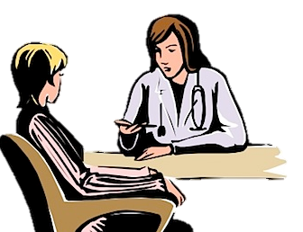



Moving from an Individual to a Population Approach
Community-Wide Prevention Population Health
Individual Medical Care
Source: Clip Art

Slide 20
Factors Influencing Health
Genetics
Behavior & Environment
Healthcare

Slide 21
Factors Influencing Health

Slide 22
Current Health Care Spending
$2.7 Trillion
Behaviors & Environment
70%
Genetics
20%
Medical Care, 10%
Factors Influencing
Health
National Health
Expenditures
References: Bipartisan Policy Center. “Lots to Lose: How America’s Health and Obesity Crisis Threatens our Economic Future.” June 2012
Notes:
22

Slide 23
Current Health Care Spending
$2.7 Trillion
Prevention, 3%
Behaviors & Environment
70%
Health Care Services
97%
Genetics
20%
Medical Care, 10%
Factors Influencing
Health
National Health
Expenditures
References: Bipartisan Policy Center. “Lots to Lose: How America’s Health and Obesity Crisis Threatens our Economic Future.” June 2012
Notes:
23

Slide 24
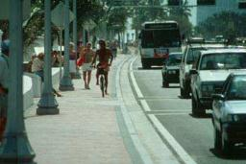
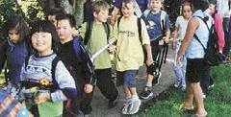

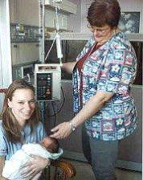
A Paradigm Shift
Notes:
Is there a source for this?

Slide 25
QUALITY
Prevention
is the Prescription
Comprehensive
Aimed at the community environment
Changes norms:
Makes healthy options
the default

Slide 26

COMMUNITY SUPPORT
PREVENTION
Prevention and Community Support
Source: https://pixabay.com/static/uploads/photo/2014/04/03/11/51/circle-312343_960_720.png
Notes:
Prevention and community support

Slide 27

Strategies and Solutions
Source: Clip Art
Notes:
Solutions? / what do we do about it

Slide 28

Source: https://encrypted-tbn3.gstatic.com/images?q=tbn:ANd9GcT5gleWW3JhAlyN09GczZoJaWP8AgULMsQokd-oAEEQlF_wcbjZmg
Notes:
Hospital Image

Slide 29
Behavioral Health’s Impact on Physical Health
Mental illness is one of the three most costly conditions for the most costly 5 % of high utilizers, having a treatment prevalence of 59 %
Children that experience/witness abuse are more likely face: depression, PTSD, STIs, heart disease, asthma, and food related health issues (ACEs Study)
Alcohol consumption is a leading risk factor for mortality and morbidity related to injury (WHO)
Notes:
1) High utilizer document 2) ACES study 3) Alcohol and Injuries Emergency Department Studies in
an International Perspective http://www.who.int/substance_abuse/msbalcinuries.pdf
Check facts
Mental illness was commonly found among the most costly cohorts.
Among the most costly 5% of the population, mental illness of any kind had a treatment prevalence of 59%.
From: DHCS Research and Analytic Studies Division. Understanding Medi-Cal’s High Cost Population. http://www.chcf.org/~/media/MEDIA%20LIBRARY%20Files/PDF/PDF%20D/PDF%20DataSymposium03042015Watkins.pdf. Published March 2015. Accessed January 29, 2016.

Slide 30
Community-Centered Health Home
Patient-Centered Medical Home
Medical Home
Notes:
CCHH
Community-Centered Health Homes
Moving from medical home to patient centered health homes is what is happening right now. But out perspective is that if so much of the determinants of health occuring at community level, then need to think about new concept: CCHH
An evolving approach to health: This work is about making linkages between high quality medical services and the community environment. This vision stems from the innovative work of physicians like Dr. Jack Geiger and Dr. Bob Sanders, thinking beyond simply integrating health care and community services, but truly aligning the health care institution with community efforts.

Slide 31
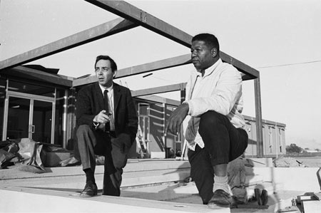
A Different Way
to Think about Health Care
Photo Credit: Daniel Bernstein
Notes:
Dr. H. Jack Geiger and Dr. John W. Hatch during construction on the Delta Health Center, 1968
Dr. John W. Hatch, who joined the health center at the outset of the project before the building was even completed, led a program to establish ten local community health associations. These groups talked with local residents to evaluate their health care needs, nominated people for work at the center, and planned satellite centers to extend the reach of services.

Slide 32

Notes:
Prescribing food…

Slide 33

“The last time we looked in the book, the specific therapy for malnutrition was food.”
Jack Geiger, MD

Slide 34
From Individuals to Communities
Patient Intake
Transferable to:
Community
Prevention
Diagnosis
Treatment
Notes:
Before I go over some of the elements in detail, I want to point out that many of the skills required for engaging in community prevention efforts are familiar to health care providers. Clinicians already engage in INQUIRY (collecting data; symptoms, vital signs, etc.) – ANALYSIS (diagnosis) – ACTION (treatment). These skills are transferable to the community prevention efforts of a community-centered health home.
Which include the inquiry phase which involves capturing and identifing population health trends, the analysis phase which involves prioritizing relevant community conditions, and the action phase which involves to engaging in advocacy and translating priorities into action

Slide 35
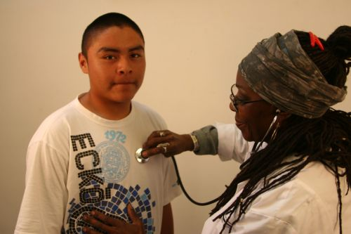
One-On-One Healthcare
Source: https://lh3.googleusercontent.com/N-Pa8uMBka6VNuolzygJiVTMXyugYmxx6Q57mirli2KB7HlCOmLtZ0I8f7fZiZxho9NY=s128

Slide 36
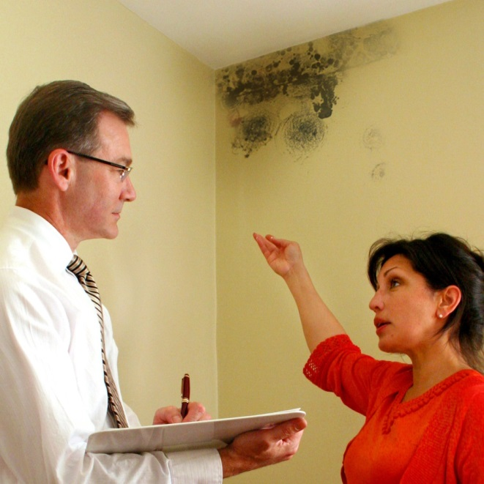
Individualized Service
Source: http://35727ec9c4540fa3fee5-978f006dd90b95268a106ef80642bdd6.r30.cf5.rackcdn.com/wp-content/uploads/2013/07/mold-inspection.jpg

Slide 37
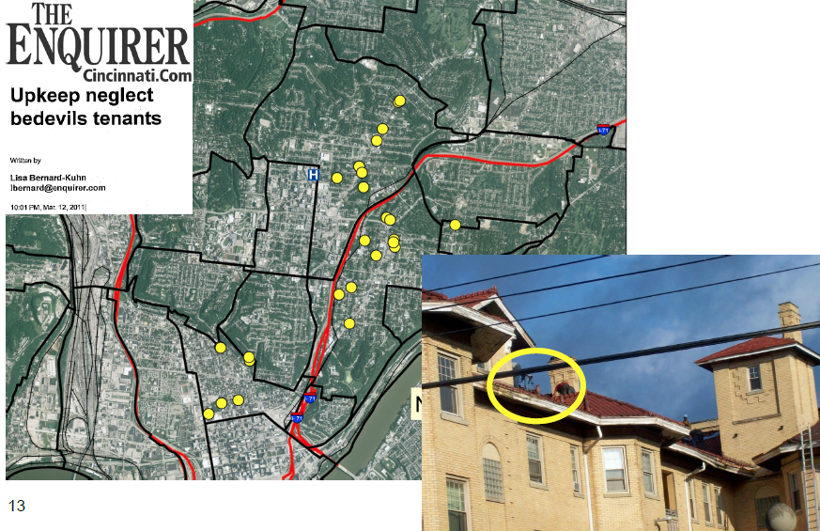
Community-Wide Action
Source: Cincinnati Children’s Community Health Initiative
Notes:
Like St Johns, Cincinnati Children’s then partnered with the local legal aid society to put legal pressure on the landlords who owned these units to improve their conditions up to code and address the asthma triggers
They also garnered some local media attention to the issue
Through these actions, they compelled landlords to improve the conditions of the units they owned, and have seen improvement in asthma admission rates from the residents

Slide 38
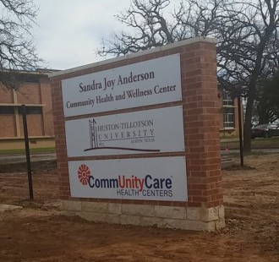
Sandra Joy Anderson Community Health and Wellness Center
Austin, Texas
Help address mental health disparities and increase health and wellness across the East Austin community
Photo by Huston-Tillotson University
Notes:
This is an example of Healthcare (Dell Medical School and CommUNITY Care) acknowledging factors outside the healthcare system impact health outcomes and actively participating in improving them – MH disparities, access to care, workforce development
Dell Medical School and Huston-Tillotson University recognized the role providers of color play in the provision of care in communities of color and acknowledged disparities in mental and physical health outcomes. These partners set out to establish the Sandra Joy Anderson Community Health and Wellness Center.
Based on their goals listed on the slide, any thoughts on what THRIVE factors this CCHH-like model addresses?
THRIVE factors such as the People Cluster (social networks & trust, participation & willingness to act for the common good, norms & culture) and Equitable Opportunity Cluster (education, living wages & local wealth)
http://htu.edu/31368/sandra-joy-anderson-community-health-and-wellness-center-to-open
http://htu.edu/27573/landmark-ht-ut-partnership-will-expand-health-services-in-east-austin

Slide 39
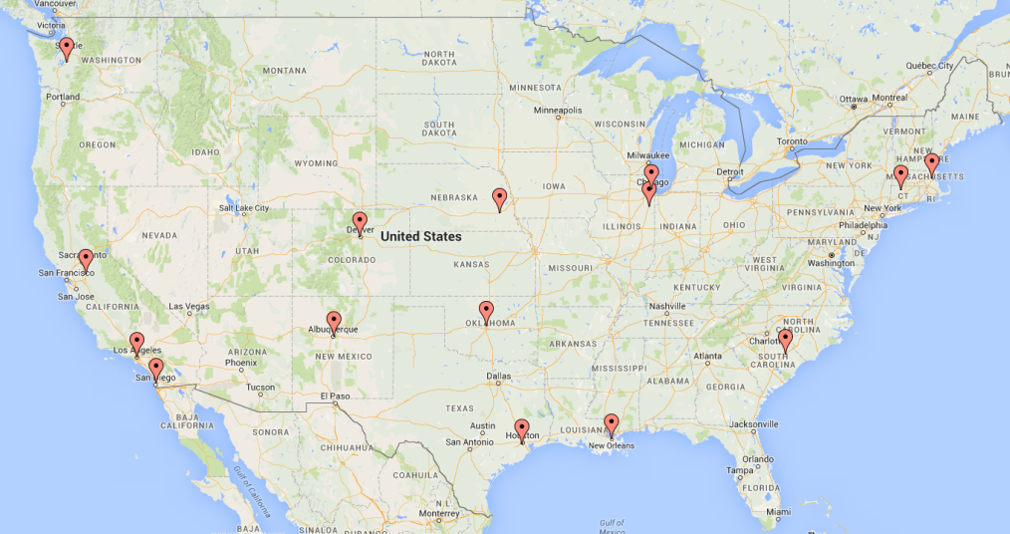
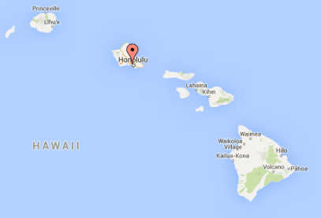

Reducing Trauma: Making Connections
https://batchgeo.com/map/
Source: https://batchgeo.com/map/
Notes:
Sixteen sites were selected – 3 are lead by healthcare organizations.
Applications were received from organizations in 35 states and Washington, D.C. allowing for the selection of a geographically diverse cohort.

Slide 40

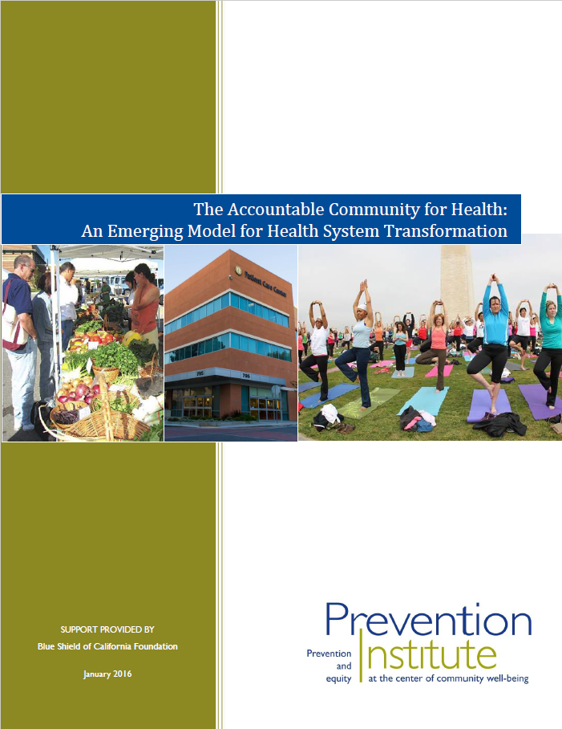
Accountable Community for Health
Notes:
Move from Community Clinics to a Systems Approach
The ACH is an innovative, pioneering model that helps move the nation into the next phase of health system transformation by providing a way for healthcare groups and community initiatives and public health to join forces to improve community health, and reduce unnecessary healthcare utilization and costs. It was original conceived as part of the State Health Care Innovation Plan. Healthcare must be engaged as a lead or active partner.
New payment models encourage healthcare systems to address the social, economic, and physical environmental factors that influence their patients' health outside the clinic walls. ACHs provide a means and method for healthcare groups to work with external groups to shape environments that maximize health for all- and potentially reduce costs.
CMMI Funding to support AHC - $157 million, 5-year CMS initiative to bridge clinical care with social services and supports of a geographically defined areas of CMS beneficiaries through enhanced clinical-community linkages. Letter of Intent Feb 8, 2016. Application March 31, 2016. Washington and Minnesota have used CMMI’s State Innovation Models funds to support ACH-like activities.
California Accountable Communities for Health Initiative (CACHI) – Consortium of funders (TCE, BSCF, KP) supporting up to 6 pilot ACHs in CA for 3 years. Requires the establishment of a wellness fund. Applications due 4/29/16
Difference between two models: ACH moves beyond clinical-community linkages to active engagement in community-wide efforts to improve community conditions that influence health, safety, and equity.

Slide 41
Expanding towards a System of Prevention
From
To
Sick care
Prevention, health, wellness, and then treatment
Behavioral Health and Healthcare just as a service provider
As facilitators and catalysts for change
People in the population as patients
Focused on community determinants
Fragmented prevention programs and services
Coordinated Prevention Policies, Practices and Programs / Services

Slide 42
Expanding towards a System of Prevention
From
To
“After the fact”
“In the first place”

Slide 43
Interactive Activity #2
First alone, then in your pair, then your small group, compile a list of skills in answer to:
What key skills should leaders develop to work effectively with communities to improve population-level behavioral health outcomes?
8 minutes

Slide 44
Behavioral Health Skills and Approaches
Addressing the community environment
Collaborating with multiple sectors
Commitment to Advancing Equity
Shifting norms and behavior
  Advocating for policy and org practice change
  Understanding the changing healthcare system
Notes:
Make into two slides keep first bullet, third bullet on own slide (move after two pictures chronic condition s)

Slide 45
Behavioral Health Skills and Approaches
Facilitating & Catalyzing
Promoting resilience, violence prevention, mental health, stigma reduction
Understanding community experiences
Engaging peer support

Slide 46
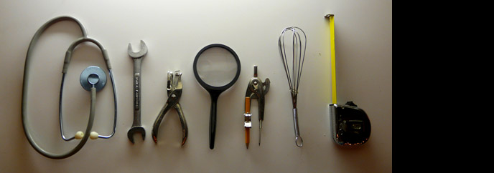
Tools for the Transition
Photo credit: Emily Barney
Notes:
4/2/08
Do we want the points?

Slide 47
The Spectrum of Prevention
Influencing Policy & Legislation
Changing Organizational Practices
Fostering Coalitions & Networks
Educating Providers
Promoting Community Education
Strengthening Individual Knowledge & Skills
Swift & Cohen. Injury Prevention (1999)
Notes:
47
LC developed this tool in collaboration with a few others when he worked in county government – he worked as the director of the Prevention Program and they would go around and talk to people about the importance of prevention. People would say that they work in prevention. When asked what they do (related to tobacco control – main issue at the time) – they would say they print brochures about the harmful effects of smoking and the importance of quitting smoking. The tool emerged from the need to differentiate various types of prevention activities.
The beauty of the spectrum is that it gives us a roadmap for how to develop a comprehensive set of strategies. It also shows us that activity at no one level alone is enough. The Spectrum is useful for both the CCHH and ACH models.
Sandra Joy Anderson Community Health and Wellness Center is using changes to organizational practices and policies to explicitly focus on increasing the number of African American mental health physicians in Central Texas in addition to being a community resource to strengthen individual knowledge & skills and promote community education. The partnerships across the community has fostered coalitions and networks that are working together to evaluate the success of employment programs for individuals diagnosed with serious mental illness. What’s great about this example is the Anderson Community Health and Wellness Center is not just training providers but they also serve support the development of trust between the community and providers and model occupational opportunities that may not be evident to youth in the community. In some communities organizational practices may have a greater impact on the community that legislation or policy development. As the Wellness Center evolves, its partnership with healthcare, safety net providers, academia, and local government will mature and can realistically lead to advocating for policy changes in the community to better support more upstream policies.
Trillium Community Health Plan changed its organizational practice by promoting a mental health friendly workplace environment. The are also examining ways to influence policy to reduce access to lethal means of self-harm and reduce availability of alcohol in local retail and social markets.

Slide 48
The Spectrum of Prevention:
Open Space Examples
Influencing Policy
Promote policies that establish green spaces, comfortable spaces and community gardens where people can connect and build relationships
Organizational Practices
Encourage educational institutions to implement joint-use agreements and increase opportunities for physical activity
Fostering Coalitions
Develop a neighborhood group to maintain the green spaces and coordinate public art or other beautification projects
Educating Providers
Train providers on CPTED II, which focuses on fostering social cohesion through environmental design
Community Education
Engage non-park professionals to understand how parks and open space contribute to health and mental health
Individual Knowledge
Encourage youth development activities that incorporate learning how to tend to a community garden
Source: Swift & Cohen. Injury Prevention (1999)
Notes:
48
Describe the importance of green, open spaces for behavioral health

Slide 49
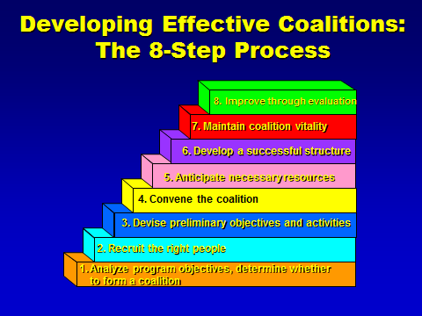
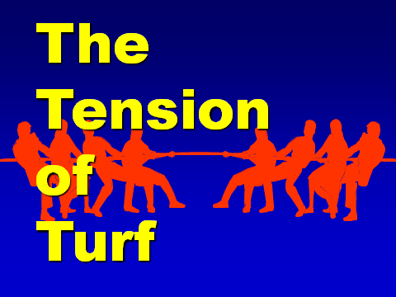

Slide 50
Collaboration Multiplier
PH
VP
Public Health
Violence Prevention
Shared Outcomes
Expertise:
Experience in population-based interventions and collection of data on chronic disease and injury rates
  Strong partnerships among partner organizations and community members
  Safe community gathering space: Urban farm
  Employment for youth and adults
  Increased access to healthy foods
  Institutional systems and local policies to promote health and safety
Expertise:
Expertise in youth violence prevention and intervention
Desired Outcomes:
Unification of collaborative efforts to address violence and chronic disease
Desired Outcomes:
Decreased gang violence and increased positive opportunities for at-risk youth
Key Strategies:
Facilitate system and policy changes that link healthy eating active living with violence prevention efforts
Partner Strengths
Key Strategies:
Build youth leadership and connect youth to training and employment opportunities
  Established trust and respect in community
  Local policy maker involvement and support
  Experience in community engagement and training
  Content expertise
  In-kind support
  Linked to broader city-wide initiatives
Urban Agriculture
UA
CC
City Council
Expertise/:
Knowledge on urban food system infrastructure and implementation
Expertise:
Knowledge and ability to influence local policy decisions
Joint Strategies
Desired Outcomes:
Long-term partnerships to achieve sustainable food systems
  Establish urban farm and farmer’s market
  Build youth capacity to understand goal and advocate for environmental and policy changes
  Build capacity of leaders
  Cultivate relationships and partnerships
  Connect youth and community residents to training and employment opportunities
Desired Outcomes:
Policies that promote health and safety in the district
Key Strategies:
Create mechanisms for residents to access fresh, affordable healthy foods
Key Strategies:
Help leverage funds for long-term sustainability
Notes:
A tool for Collaboration:
Stimulates conversation
Identifies the added value of partners
Establishes points of agreement among partners
Leverages opportunities to advance collective efforts
Orients new and existing members to the coalition
Tailors pitch to engage additional diverse partners

Slide 51
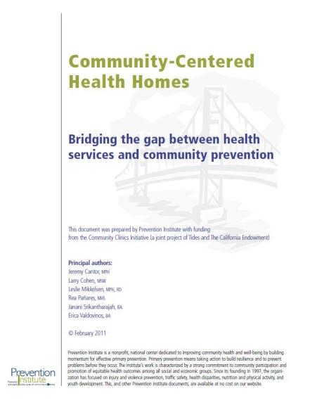
Community-Centered
Health Homes
Notes:
The CCHH is a conceptual model for health care (including community health clinics) to move upstream and systematically engage in the types of community prevention work of Dr. Jack Geiger and Dr. John Hatch
We released our initial report in 2011, which describes the model
CCHH is a conceptual model to consider as a way to help facilitate the expansion and formalization of cross-sectoral partnerships that target community health priorities, data sharing, and stronger clinical-community service integration models.
Recent brief on the CCHH model was published in January 2016. The brief is based on lessons learned from demonstration projects in Gulf States and North Carolina. Key Learnings include:
CCHH is both a model and a metaphor.
The CCHH model is flexible and fluid. NOT LINEAR → begin in area of expertise.
The CCHH model is a method for healthcare organizations.
Transformation to CCHH does not happen all at once; a common starting point is to focus on one or two key medical concerns.

Slide 52
Peer Support: Making Connections
Source: https://www.flickr.com/photos/67835627@N05/7301107446
Notes:
Peer support picture

Slide 53
Physical Health
(Healthcare)
Community/ Public Health
Behavioral Health
Mental Health
Substance Use and Disorders
Notes:
public health and an overarching prevention approach that all sectors that influence mental health behave health and physical health

Slide 54
Elements of Community Health:
THRIVE (Tool for Health and Resilience in Thriving Communities)
EQUITABLE
OPPORTUNITY
MEDICAL SERVICES
Preventative services
Access
Treatment quality, disease management, in-patient services, & alternative medicine
Cultural competence
Emergency response
Racial justice
Jobs & local ownership
Education
PLACE
What’s sold & how it’s promoted
Look, feel & safety
Parks & open space
Getting around
Housing
Air, water, soil
Arts & culture
PEOPLE
Social networks & trust
Participation & willingness to act for the common good
Acceptable behaviors & attitudes
Notes:
There are 18 factors (13 in the people, place and equitable opportunity and 5 in the medical services)

Slide 55

“Intellectuals solve problems. Geniuses prevent them.”
Albert Einstein

Slide 56
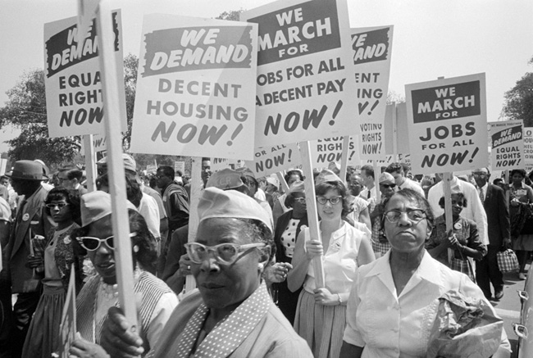
A Movement
Photo Credit: http://www.historycooperative.org/journals/jah/91.4/images/hall_fig01b.jpg
Notes:
We need a civil rights movement for health disparities.
Vision
Grassroots
Widespread
Strong leadership
Well funded

Slide 57
15% Solutions
Always there for the asking (and taking)
Most unused or unnoticed source of influence
BIG things may emerge via Butterfly effect
Reinventing the wheel is OK
Each 15% solution will add to your understanding of what is possible
Clear, common purpose & boundaries generate coherence among many small solutions

Slide 58
Interactive Activity #3: My 15%
First alone, then in your group of 2 or 3, answer this question:
Without more resources or authority, how can I more effectively lead population-focused behavioral health work in my environment?
Ask clarifying questions and offer advice to each person in your group

Slide 59

Thanks for Your Attention!
Larry Cohen, MSW
Founder and Executive Director
Prevention Institute
larry@preventioninstitute.org
Lynda E. Frost, JD, PhD
Director of Planning and Programs
Hogg Foundation for Mental Health
Lynda.Frost@austin.utexas.edu
Notes:
Mental Health, Public Health and HealthCare putting prevention in the middle of the puzzle

Slide 60
